Slide 1
SAFE PATIENT HANDLING and Mobility
Reggie Diaz Lamborn, BSN, RN, CSPHA
Safe Patient Handling & Mobility Program Manager
Office: 559-255-6100 x5743
VA Mobile: 559-287-1227

Slide 2
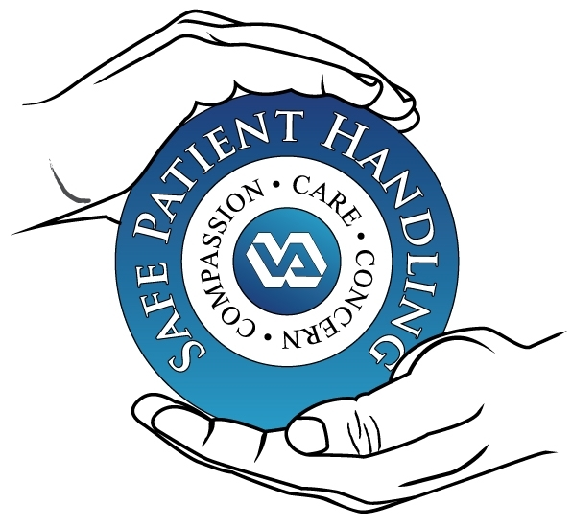

Did you know? Direct Patient Care Workers have 7 times the national average of musculoskeletal disorders. Lifting over 35 lbs without use of assistive equipment puts you at risk for injury!

Slide 3
DISABLING INJURIES
Everyday nurses suffer debilitating and often career-ending and life-altering injuries from repeatedly lifting and moving patients.
More than any other work-related injury or illness, musculoskeletal disorders are responsible for lost work time, protracted medical care, and permanent disability among health care workers.
Nursing career field suffers more musculoskeletal injuries than people in any other profession, including Firefighters, according to the latest data from the Bureau of Labor Statistics.

Slide 4
DISABLING INJURIES
Repeated lifting and forceful movements with patient care activities lead to serious health problems for health care workers.
Lifting, transferring, and repositioning patients are the most common tasks that lead to injury.

Slide 5
SAFE PATIENT HANDLING AND MOVEMENT
VA Central California has a designated SPHM program.
Unit Peer Leaders are on each unit.
Lifting equipment is available, including ceiling lifts, Sara lifts, Maxi lifts, Hover Jack/mats, roll boards, Stand Aids.
Remember to ask for help and use the lifting equipment.

Slide 6

Think about this the next time you choose not to use the lift –

Slide 7


Nurses lift an average of 1.8 tons every shift. This amounts to
576,000 pennies,
549 bricks, and yes

Slide 8
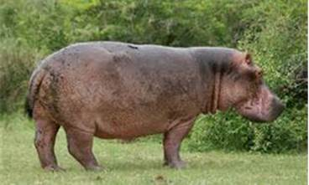
one Hippo!

Slide 9
Such strain over time results in career ending and life altering musculoskeletal disorders - in what other industry would it be permissible to lift 1.8 tons day-in and day-out?
Why should nursing be any different?!
Using equipment is like gloving and washing hands – not a mere suggestion –
An expectation all day every day!

Slide 10
SOLUTIONS ACCORDING TO DEPENDENCY LEVEL
Totally dependent patient.
Extensive assistance level.
Lifts from floor (dependent).
Limited patient assistance.
Full sling mechanical lift device.
Full sling or stand assist lift.
Full sling mechanical lift: have enough help.
Stand/assist lift: friction-reducing device.

Slide 11
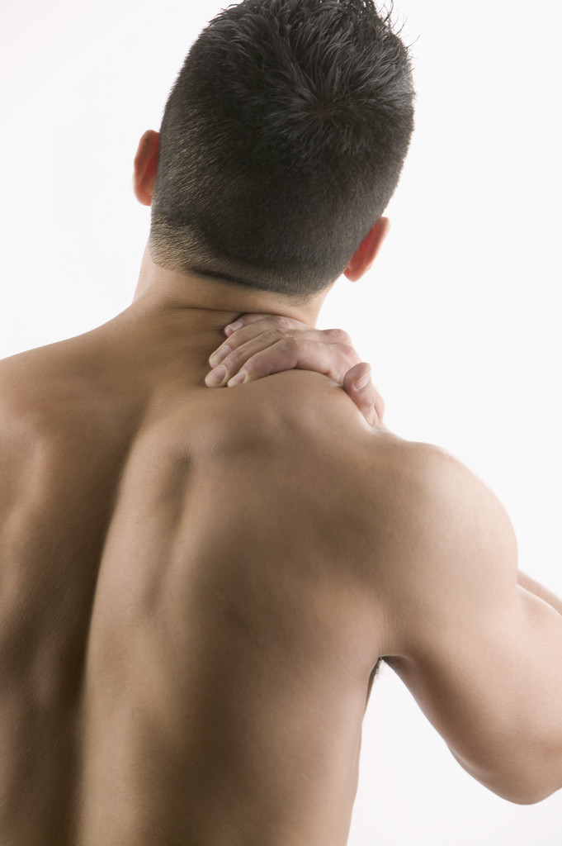
PREVENT INJURIES TO YOURSELF AND PATIENTS
KNOW YOUR UNIT PEER LEADERS .
USE THE LIFT EQUIPMENT.
ASK FOR HELP.

Slide 12

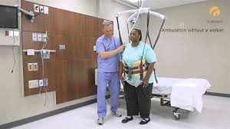
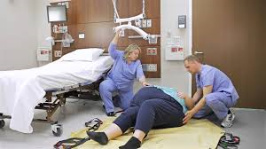
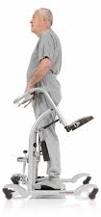
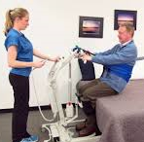
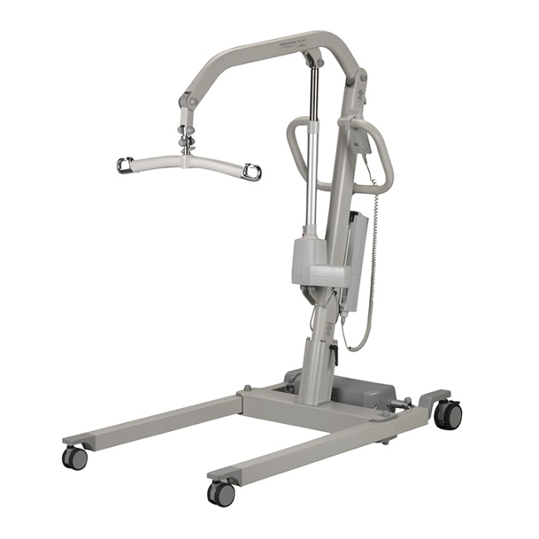
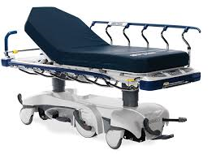
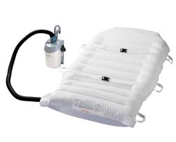
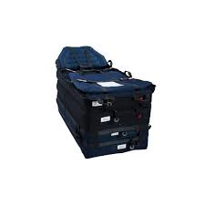
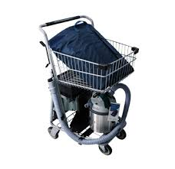
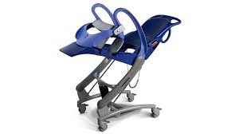

Slide 13
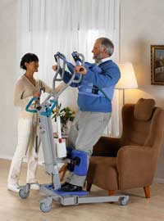
SARA 3000
https://youtu.be/lTtYo0gv-0c
Notes:
Sara 3000 3:35 mins
Steady 4:35 mins

Slide 14
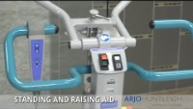

Slide 15
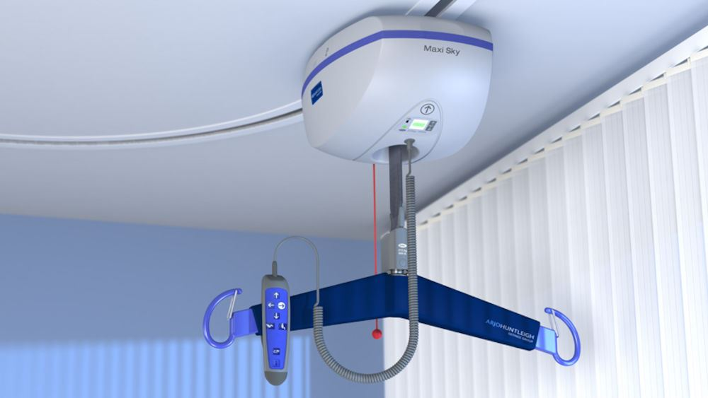
ARJO Maxi Sky 600
https://youtu.be/4yJVH2rnehM
Ceiling Lift installation started in 2008. With the goal of 100% of inpatient beds have ceiling lift coverage .
We are continually expanding our SPHM program through equipment procurement and training initiatives. Your Unit Peer Leader is your expert, find them, and utilize them to improve SPHM in your work area!
Notes:
3:47 mins

Slide 16
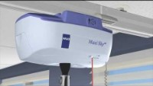

Slide 17
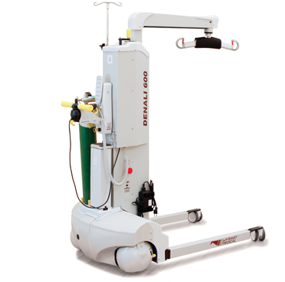
WY’ East Denali 600
https://youtu.be/kh2KM0ooxIY
Denali 600 is a great all around lift that is used in place of ceiling lift if room is without lift or workorder for repair has been placed.
Notes:
3:22 mins

Slide 18
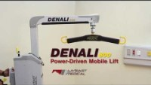

Slide 19
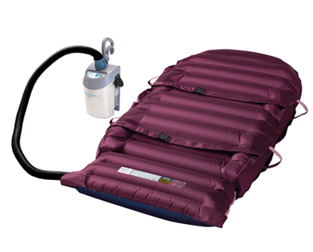
HOVER MAT https://youtu.be/fTBAI7H9-Eg
SAFE PATIENT HANDLING EQUIPMENT

Slide 20
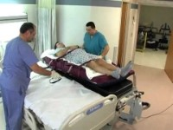

Slide 21
Thank you!
Welcome to VA Central California Health care system

Slide 22
RECOURCES
VHA Patient Safety Center: www.visn8.med.va.gov/patientsafetycenter
ANA: www.nursingworld.org/osh
OSHA: www.osha.gov/SLTC/ergonomics/index.html

